Slide 1
Murdock Hyundai
4679 South Hanauer Street

Slide 2
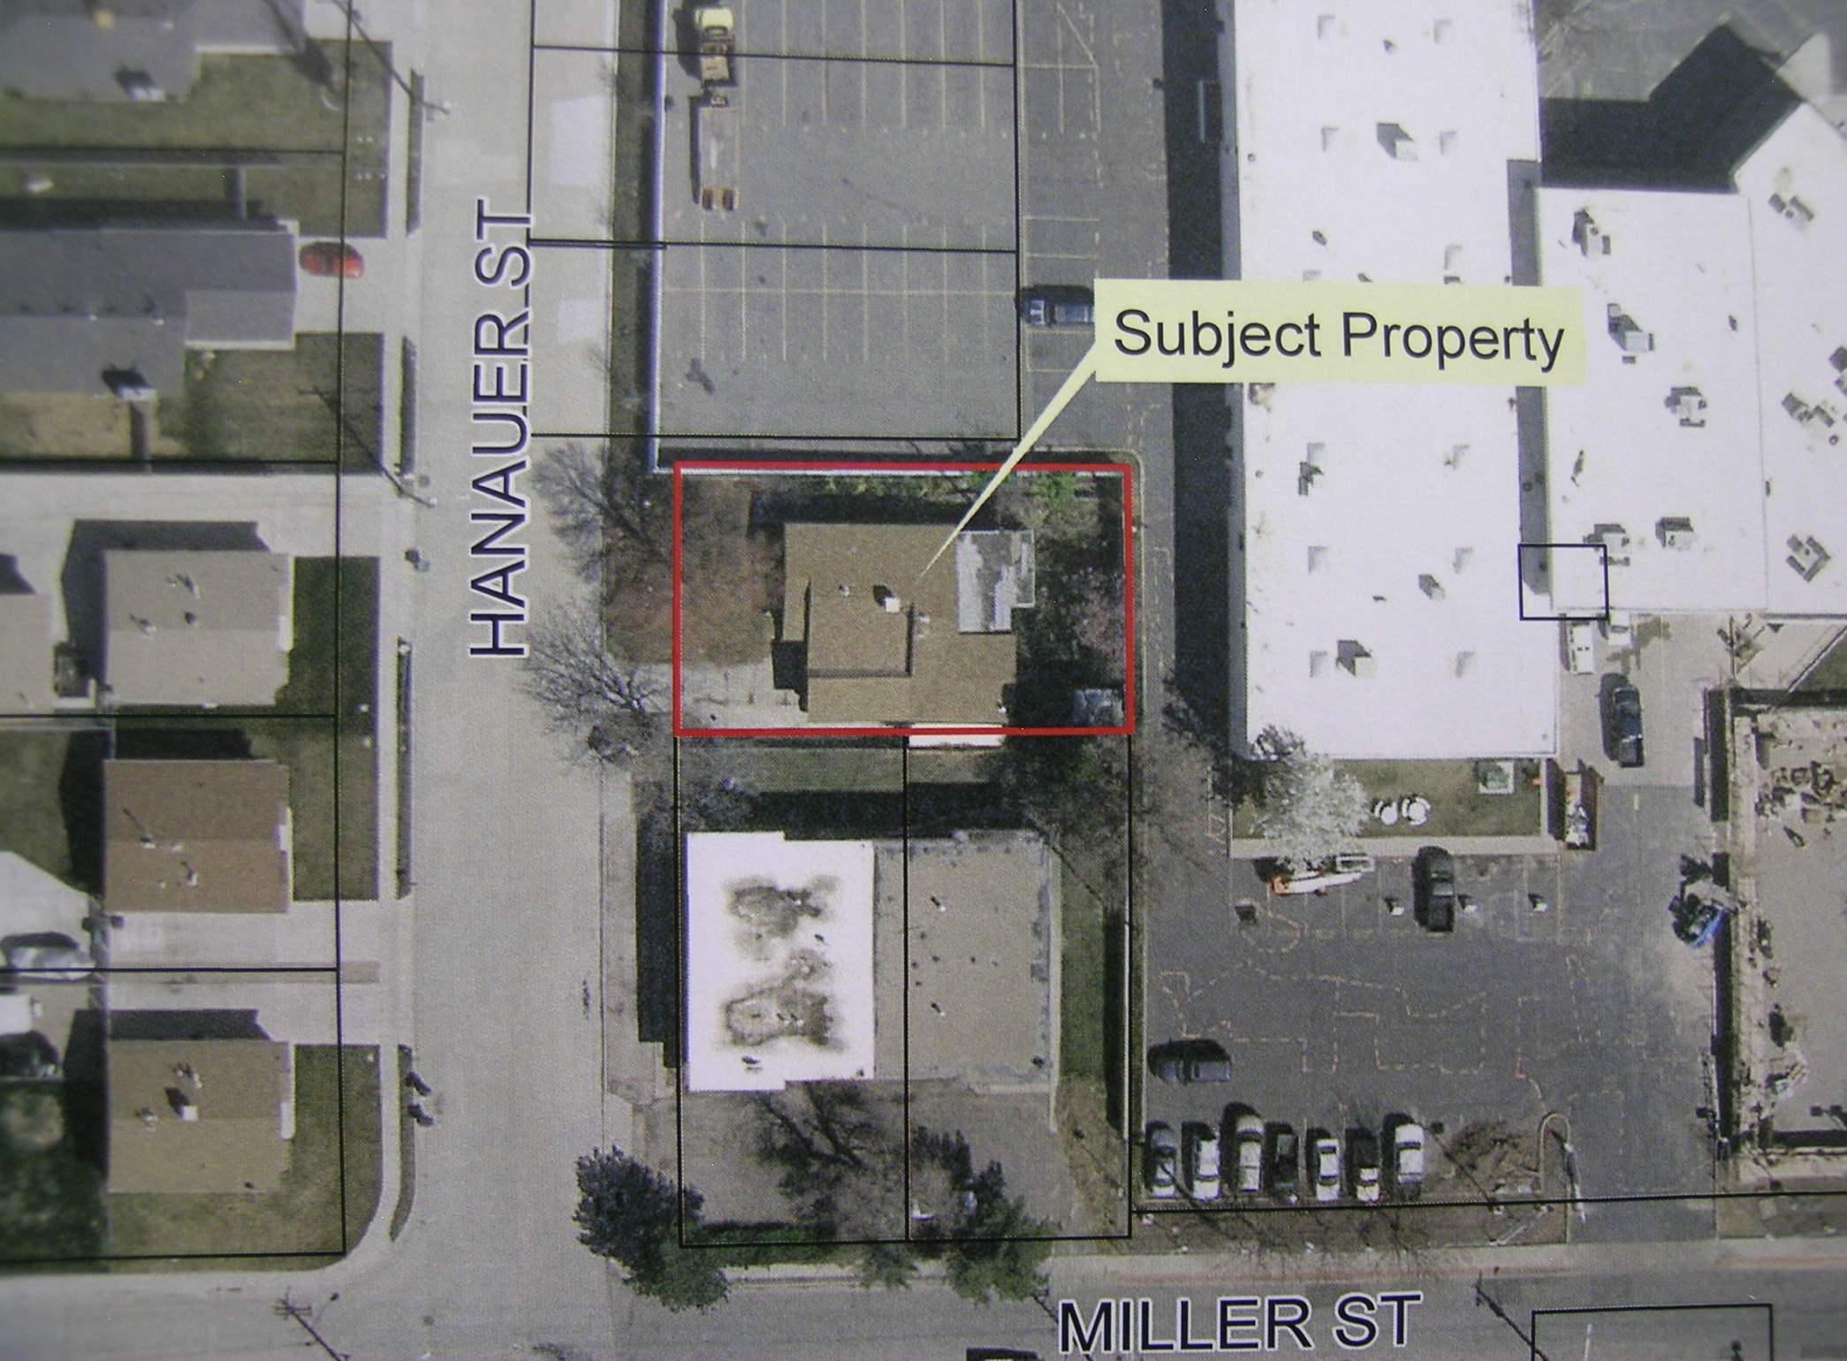

Slide 3
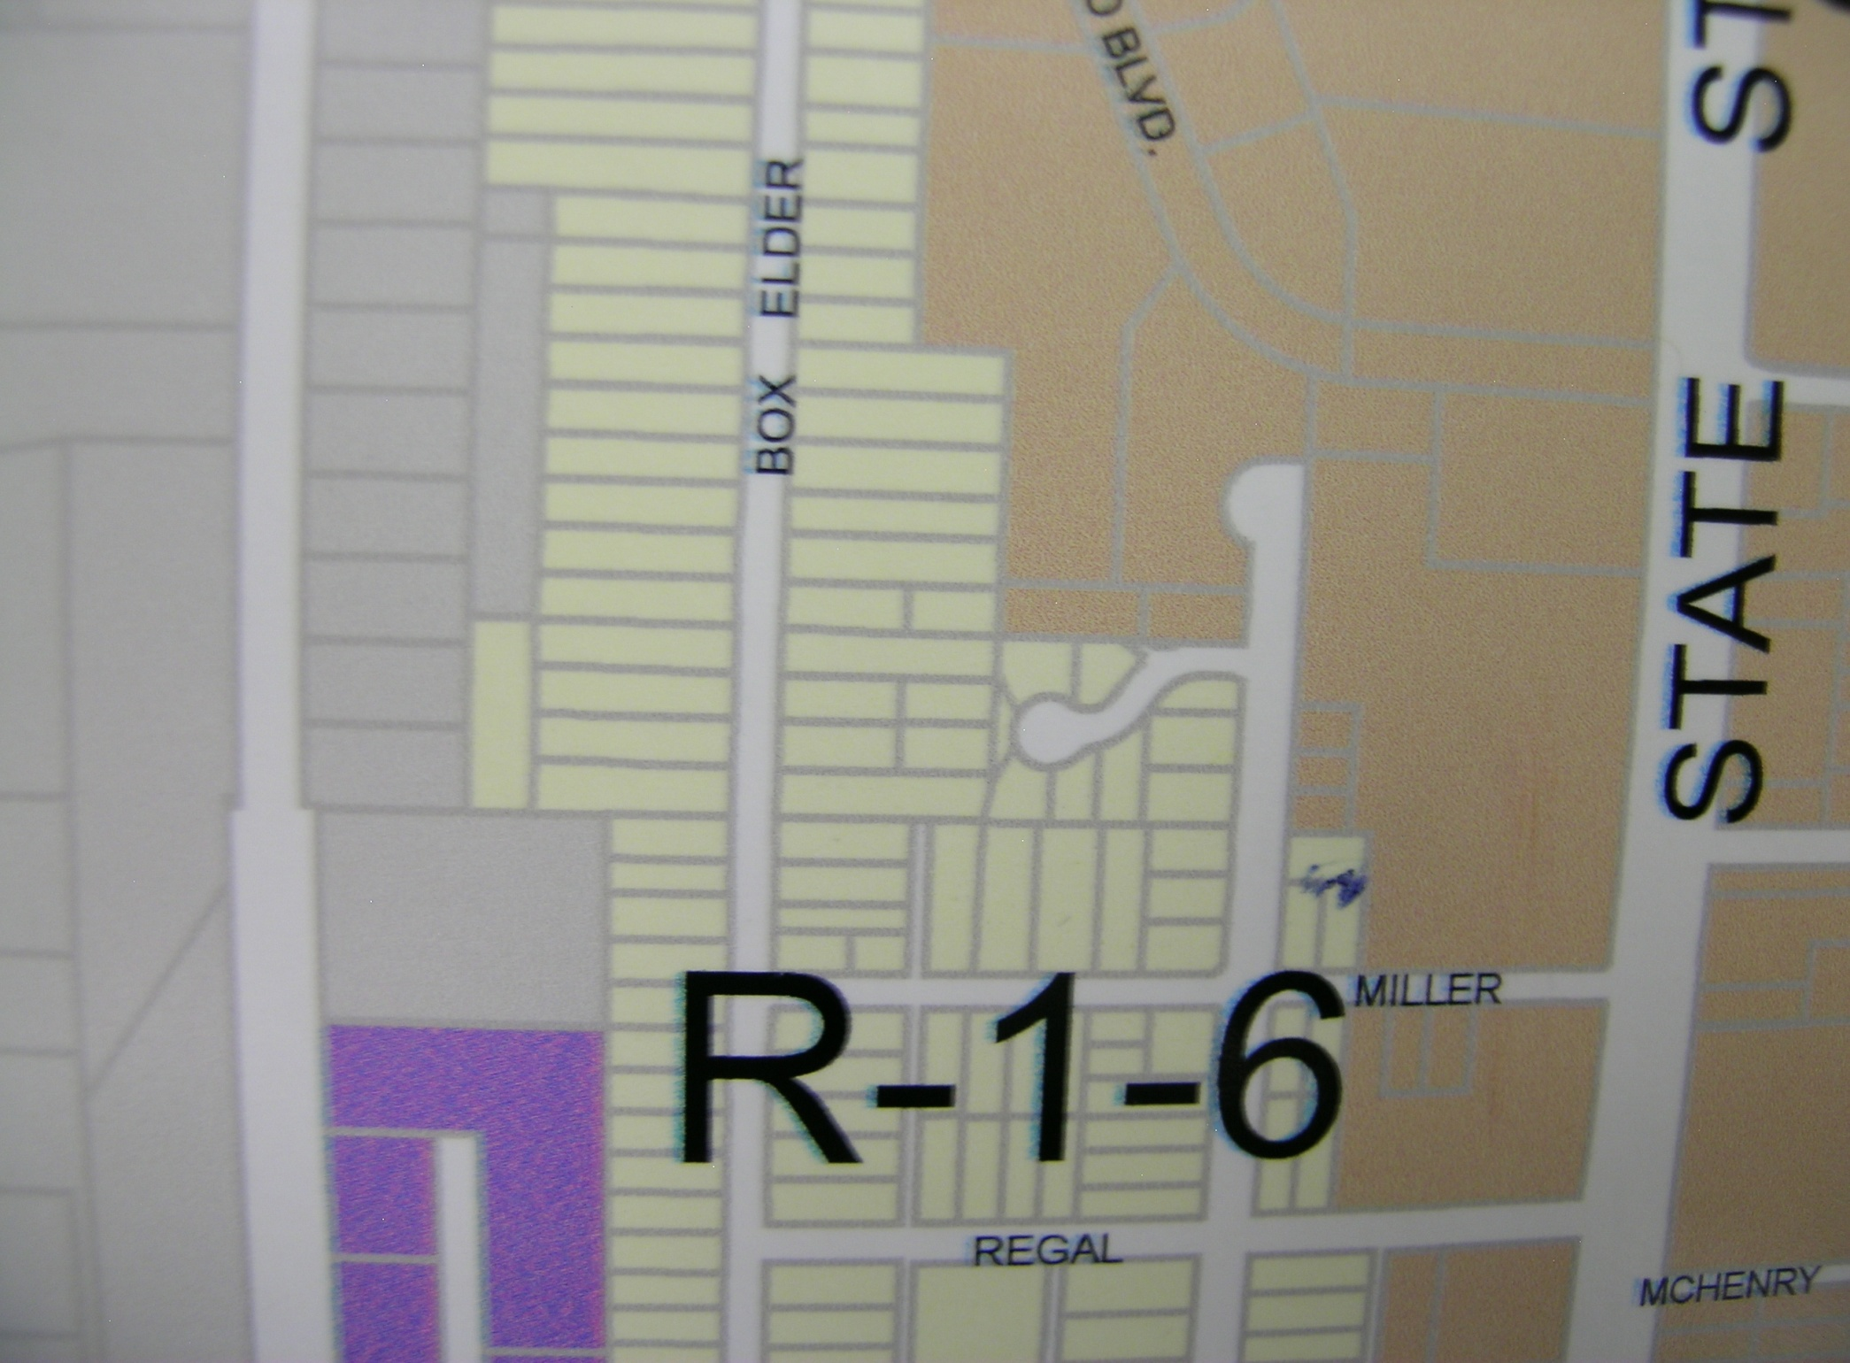

Slide 4
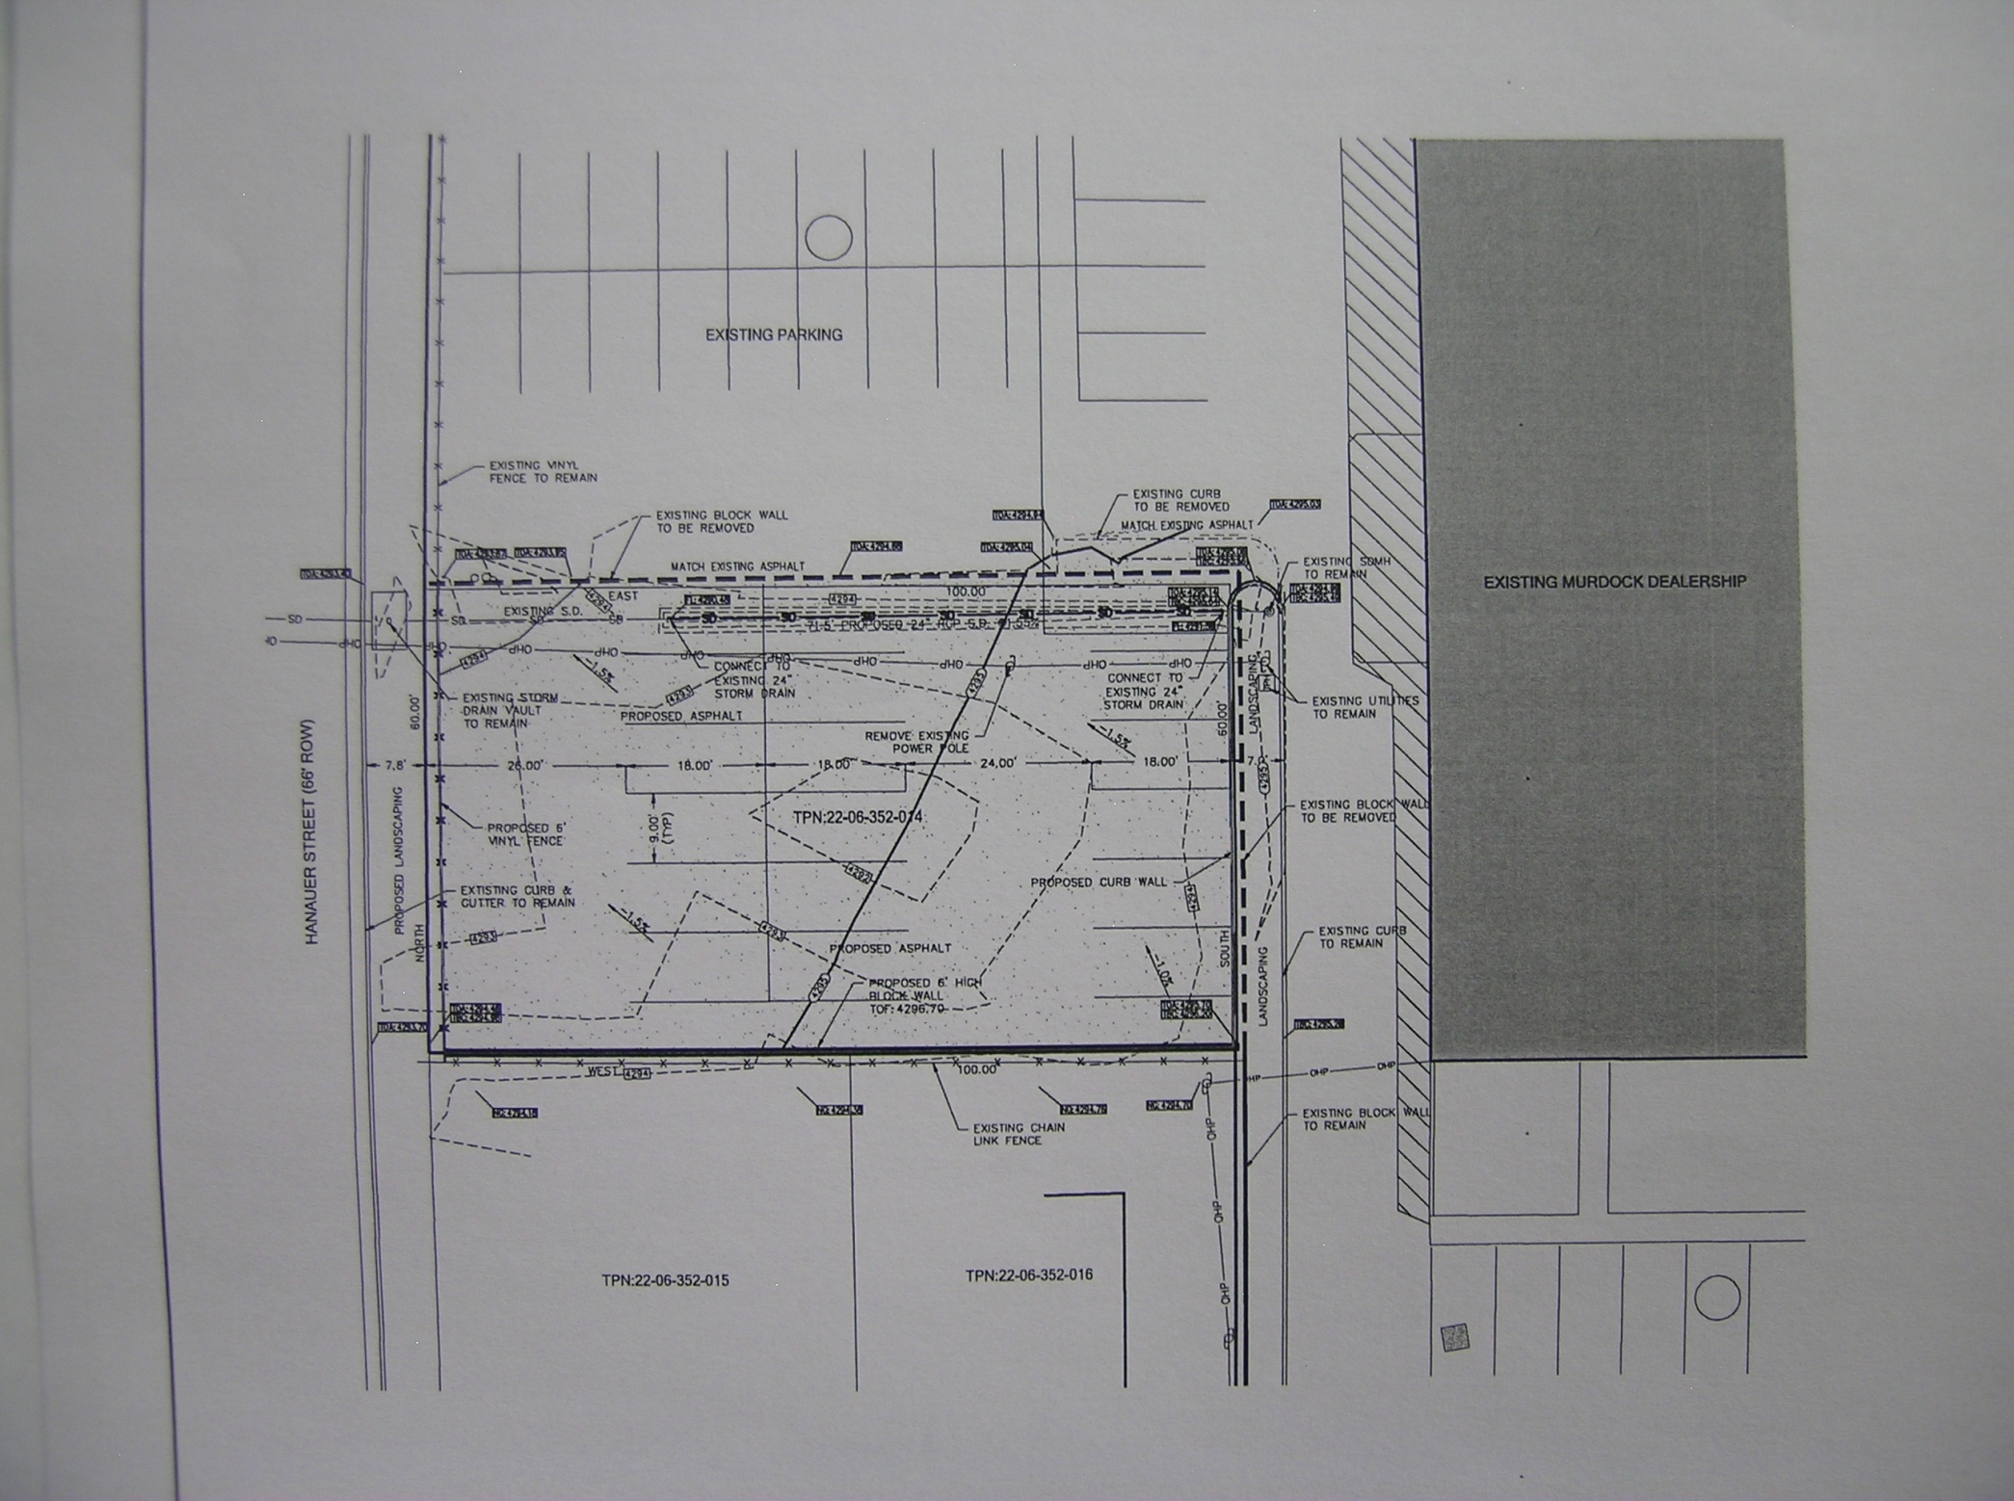

Slide 5
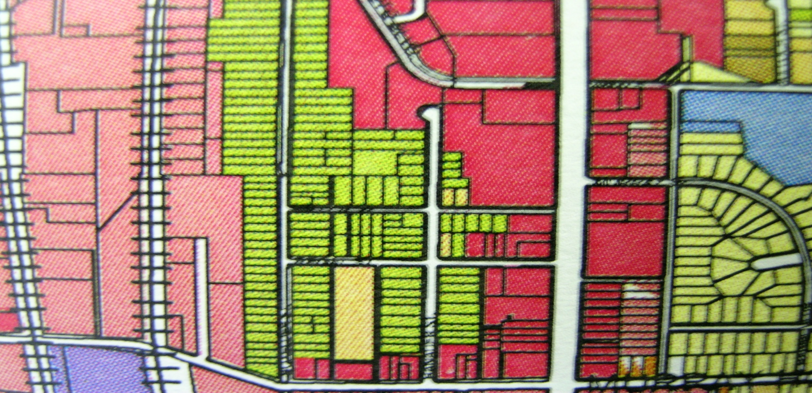
Murray General Plan
Residential Single Family Medium Density

Slide 6
Staff Recommendation
Staff recommends that the Planning Commission forward a recommendation of
Denial to the City Council for the requested General Plan Amendment and Zone Change.

Slide 7
Roger Knight & Steven Feder
703,709,753 East Winchester Street

Slide 8
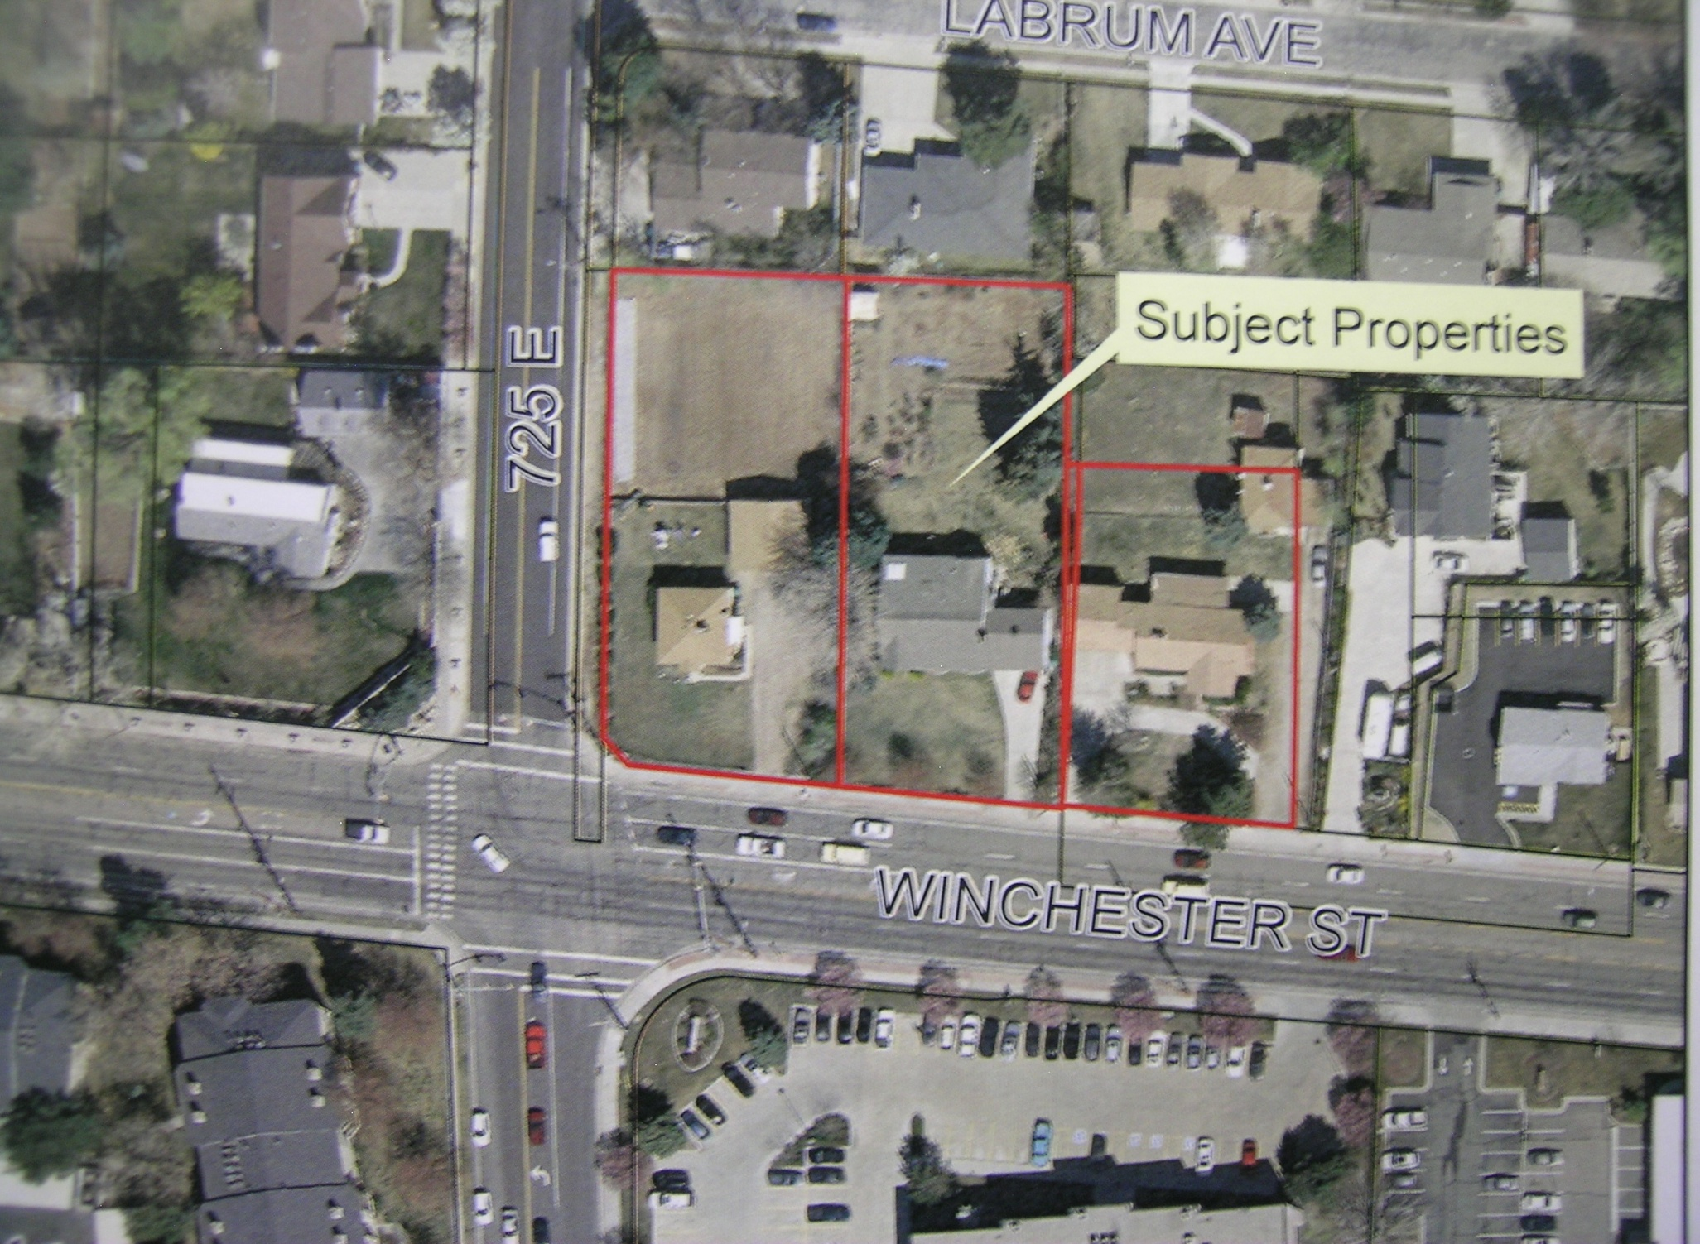

Slide 9
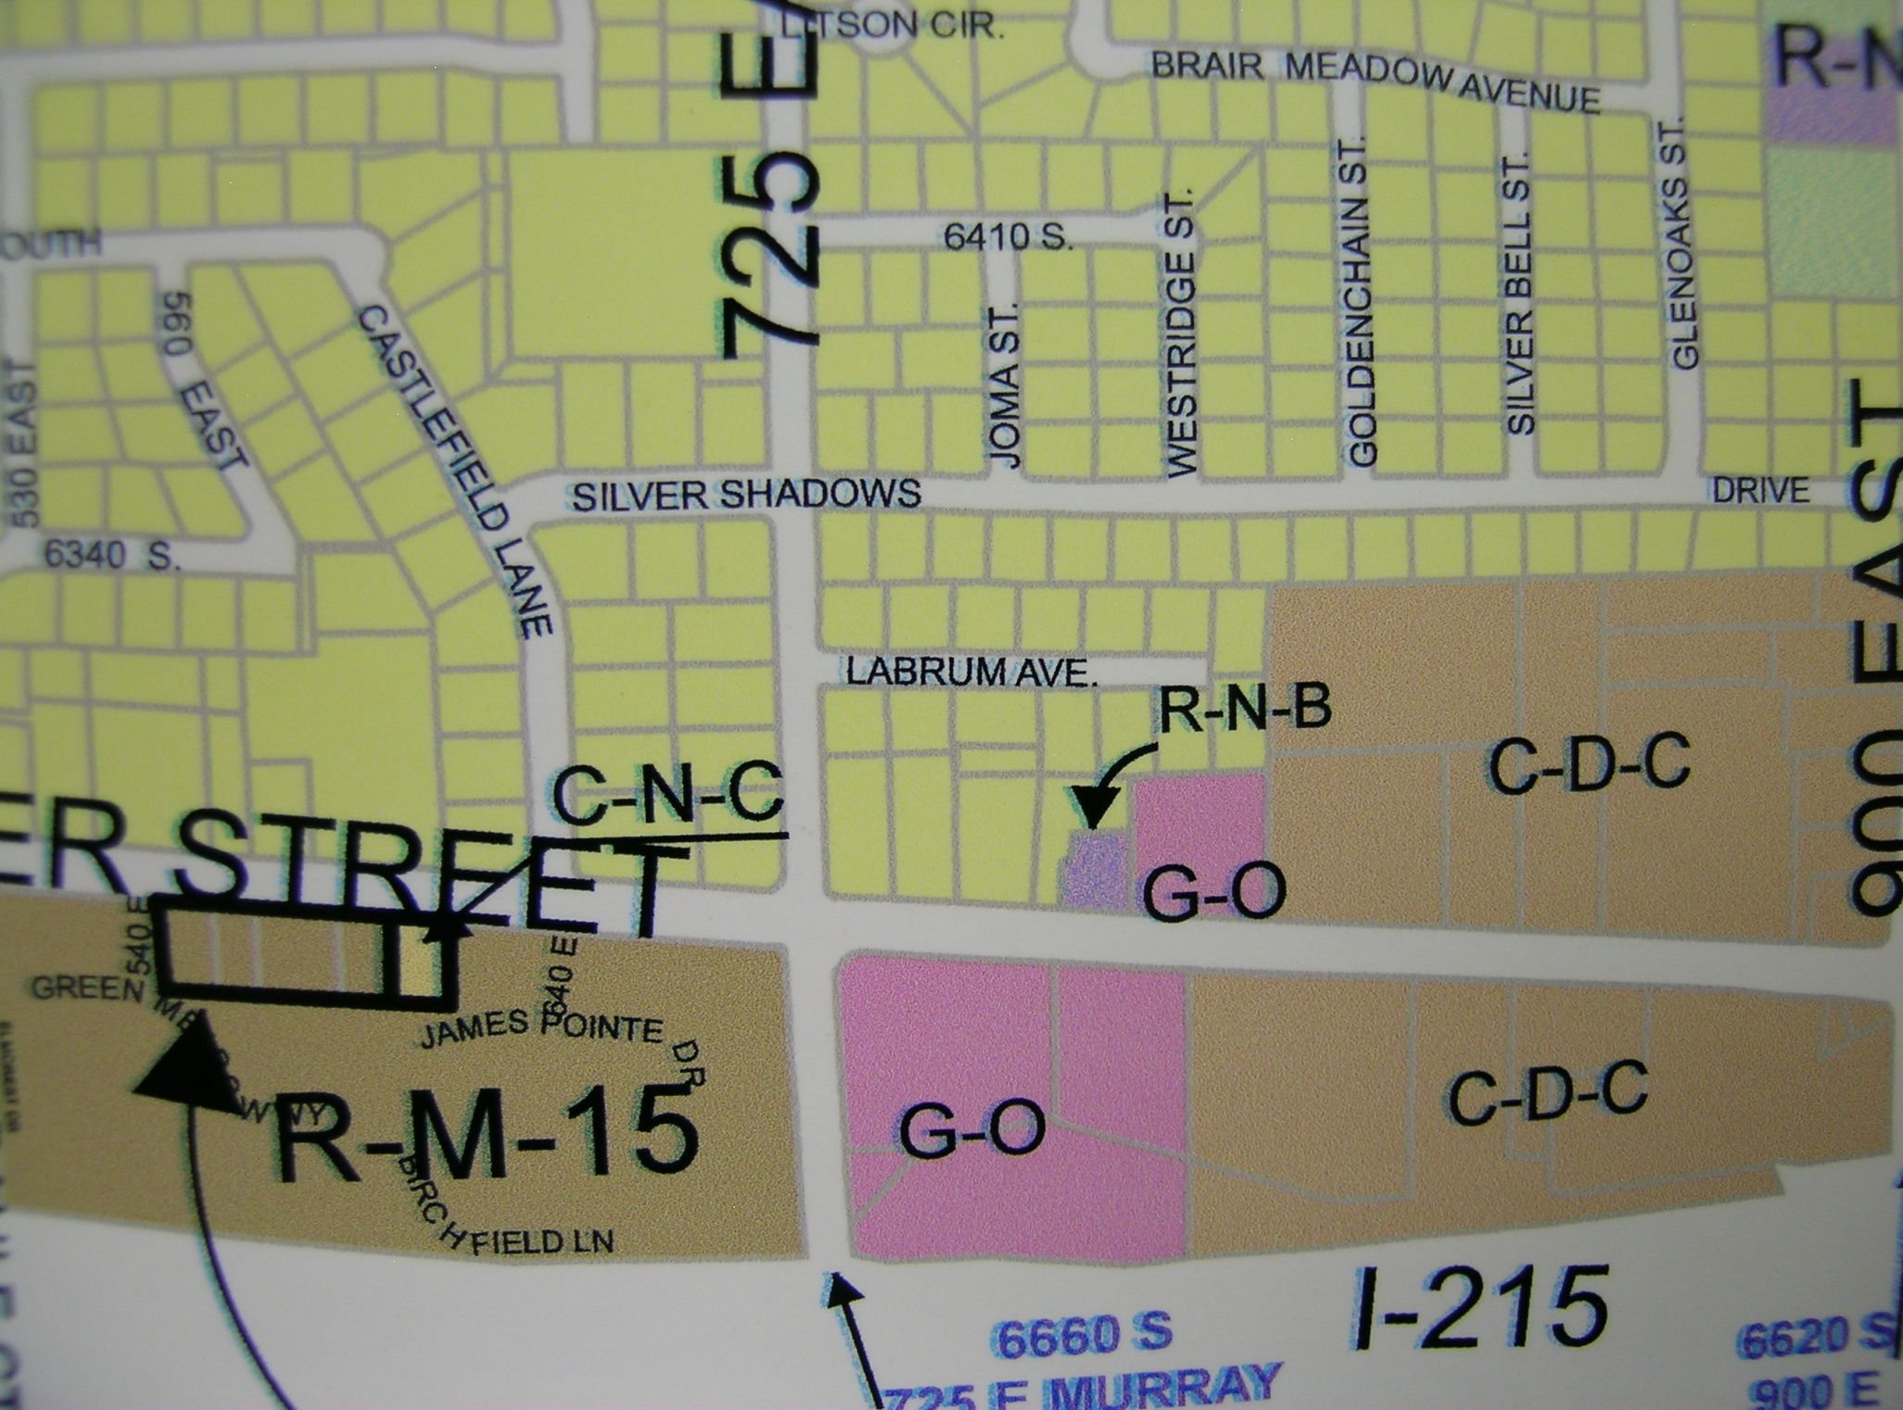
R-1-8

Slide 10
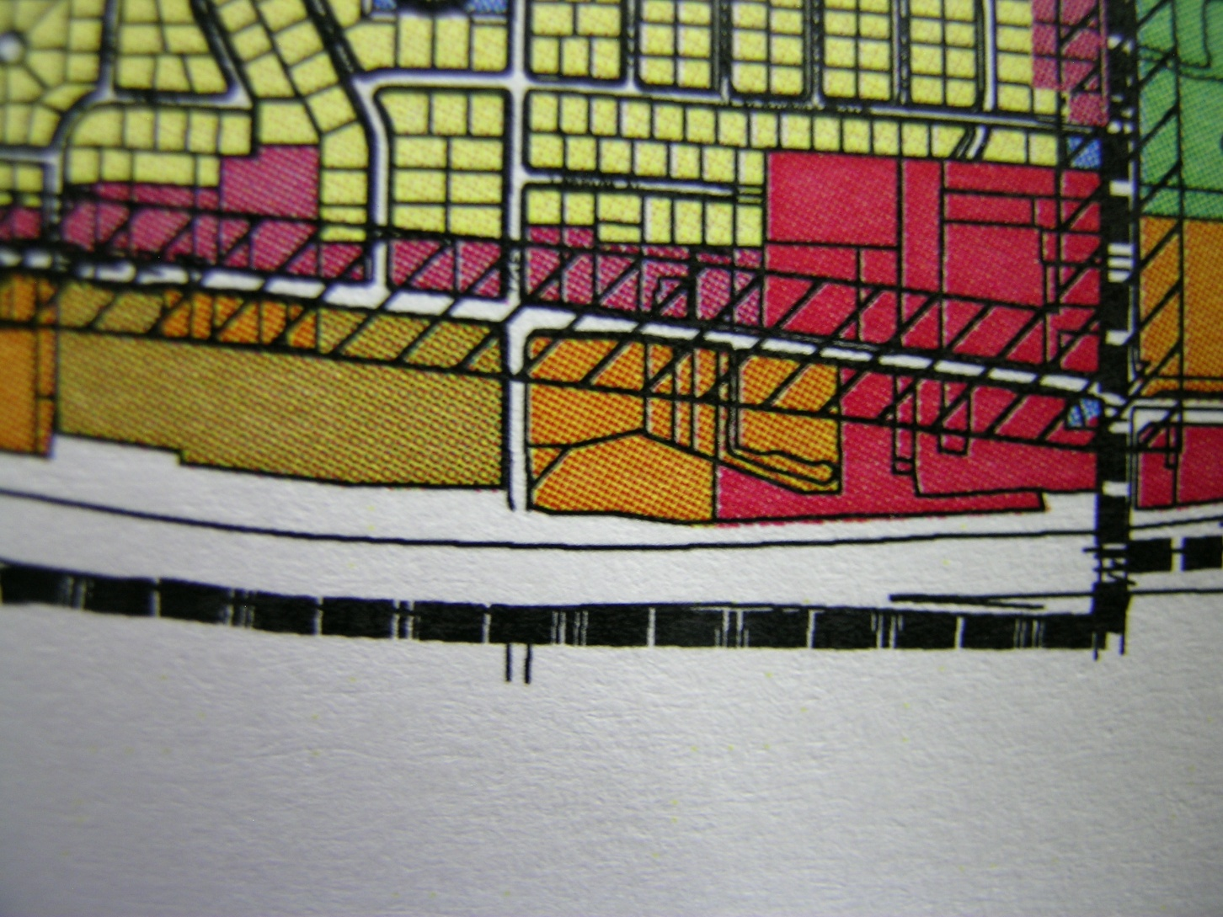
General Plan
Residential Business

Slide 11
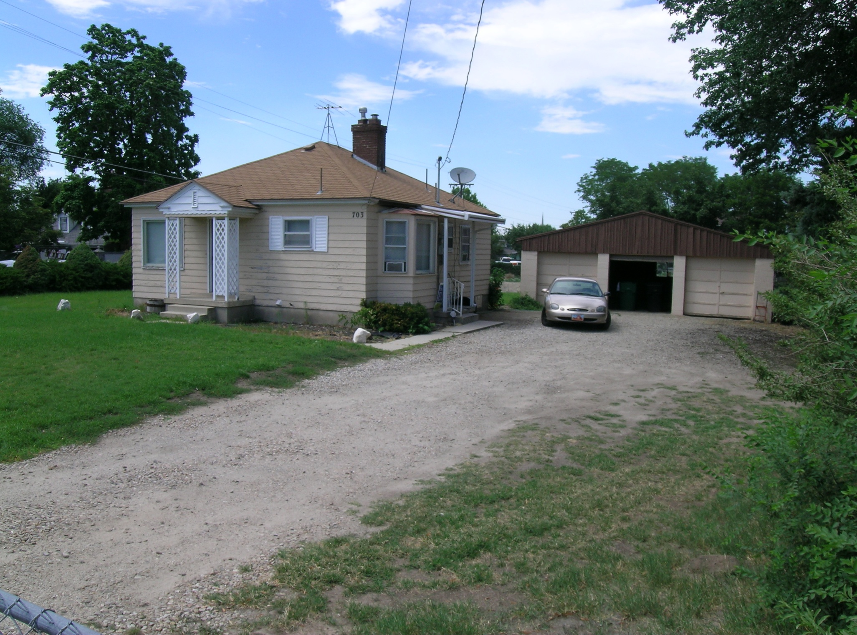

Slide 12
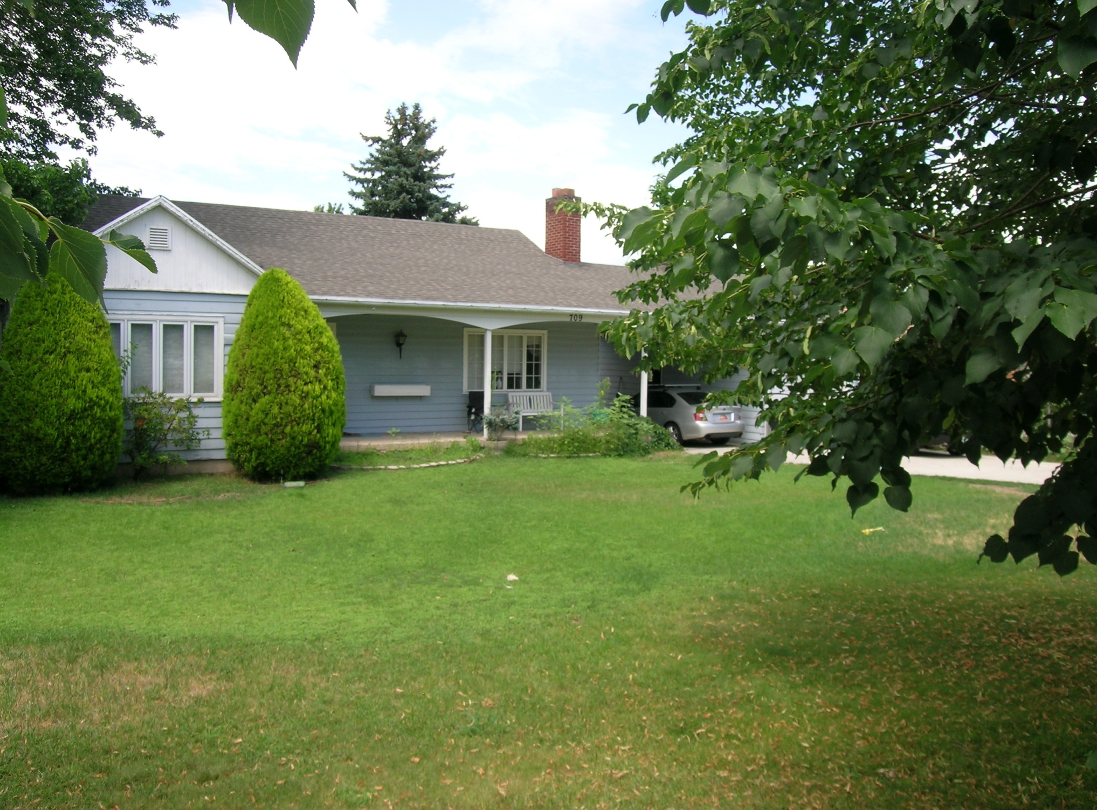

Slide 13
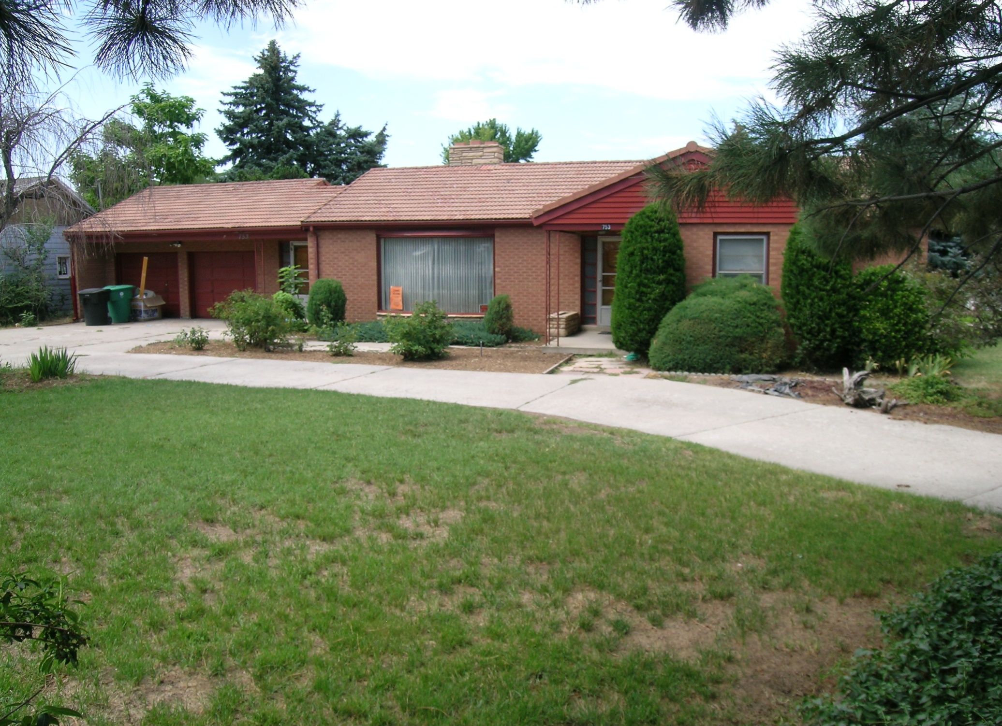

Slide 14
Staff Recommendation
Staff recommends that the Planning Commission forward a recommendation of approval to the City Council for the requested zone map amendment from R-1-8 to R-N-B.

